Slide 1

STACK OVERFLOW DEVELOPER SURVEY 2019 PRESENTATION
Sebastian Lucatero
11/30/2023

Slide 2

OUTLINE
Executive Summary
Introduction
Methodology
Results
  Visualization – Charts
  Dashboard
Discussion
  Findings & Implications
Conclusion
Appendix

Slide 3

EXECUTIVE SUMMARY
Contextualizing Data and Describing key goals of analysis
Methodology
  Data collection and Cleaning
  Exploratory Data Analysis
  Data Visualization
Results supported by trends in visualization
Discussion of results
Conclusion on research

Slide 4

INTRODUCTION
The 2019 Stack Overflow Developer Survey was a comprehensive online survey of software professionals around the world
Survey included nearly 90,000 developers
Purpose of analyzing the survey is to characterize current technologies used in the industry
Predicting future trends in use of technologies by developers

Slide 5

METHODOLOGY
Survey Data Collection and exploration
  APIs
  Web Scraping
  Library Requests
Data Wrangling
Exploratory Data Analysis
  Analyzing the data distribution, Handling Outliers, and Correlations
Data Visualization
Dashboards
  Highlight present and future desired technology usage as well as developer demographics

Slide 6
RESULTS
Over 90% of respondents identified as male
The most common age range was between 18 and 25
The countries where most people came from were from The U.S or India
The most Common programming languages were based on Webdevelopment
The most Common Databases were Open sourced
The Platforms and Webframeworks used stayed relatively consistent across time

Slide 7
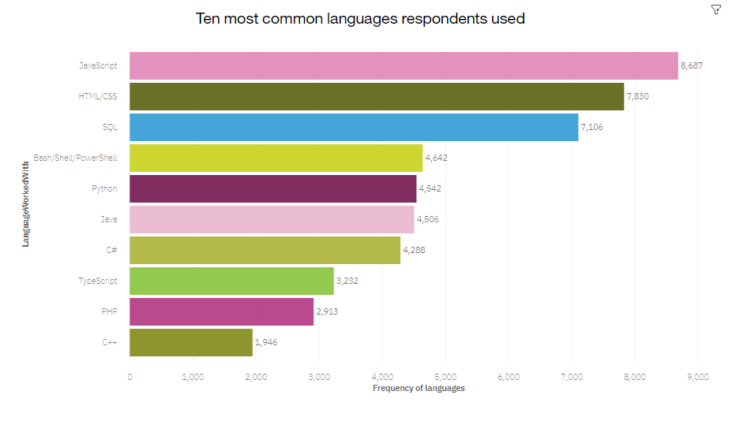
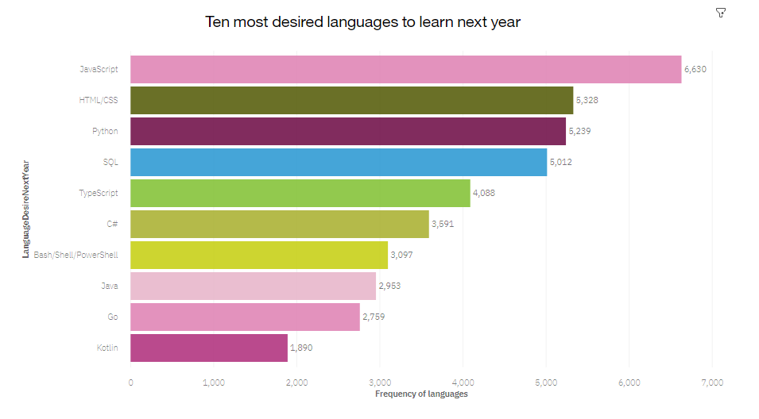
PROGRAMMING LANGUAGE TRENDS
Current Year
Next Year
<Bar chart of top 10 programming languages for the current year goes here.>
< Bar chart of top 10 programming languages for the next year goes here.>

Slide 8
PROGRAMMING LANGUAGE TRENDS - FINDINGS & IMPLICATIONS
Findings
Javascript, HTML/CSS, SQL far surpass other languages in current year
C#, Python, and Typescript are growing in popularity within next year
Bash/Shell/power is losing traction for next year
Implications
Wed and Script development is still a highly in demand skill
C# and Python are becoming popular possibly due to AI and ML
Company-wide proprietary languages like power shell might not be a safe choice to learn

Slide 9
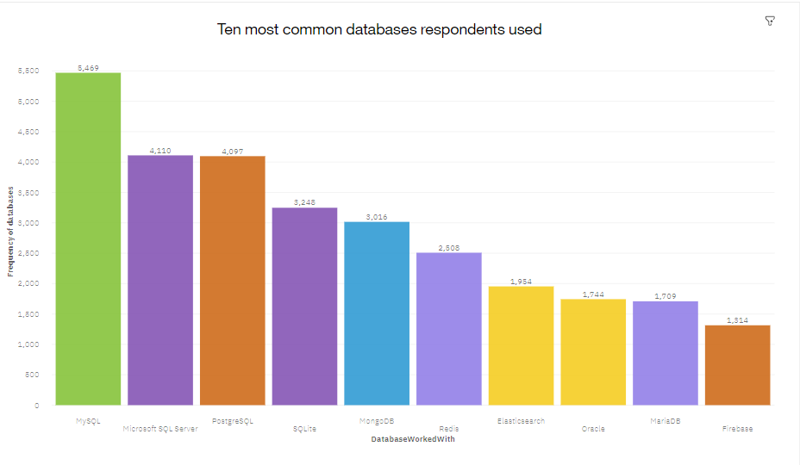
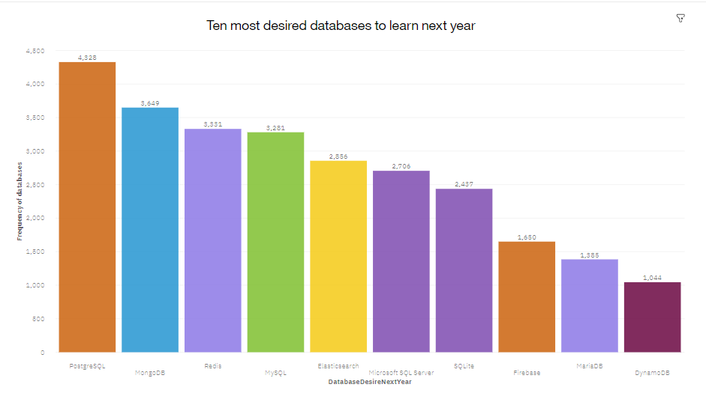
DATABASE TRENDS
Current Year
Next Year
< Bar chart of top 10 databases for the current year goes here >
< Bar chart of top 10 databases for the next year goes here.>

Slide 10
DATABASE TRENDS - FINDINGS & IMPLICATIONS
Findings
MySQL is the most popular database
MongoDB and Redis are rapidly increasing in demand
ElasticSearch unexpectedly gaining popularity
Implications
Propietary servers like microsoft SQL server possibly not an important investment in future
Open source databases like MongoDB will still be important in companies
Search engine based analytic databases will be necessary for analyst toolset

Slide 11

DASHBOARD
https://dataplatform.cloud.ibm.com/dashboards/d54f1b69-301a-446d-b9cc-f6119491654d/view/6035d8153fa220c409c8f6e4079c7e5078657359e1bb815789827b4909627297a9601392c82a4a52db195066f2ec17599b

Slide 12
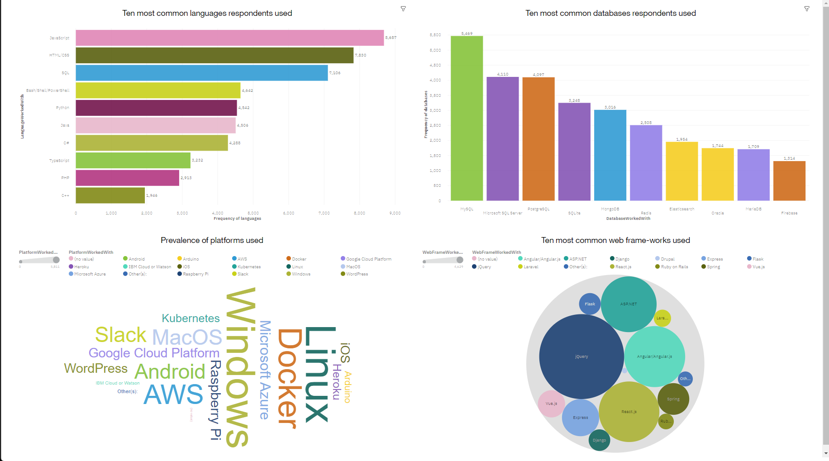
DASHBOARD TAB 1

Slide 13
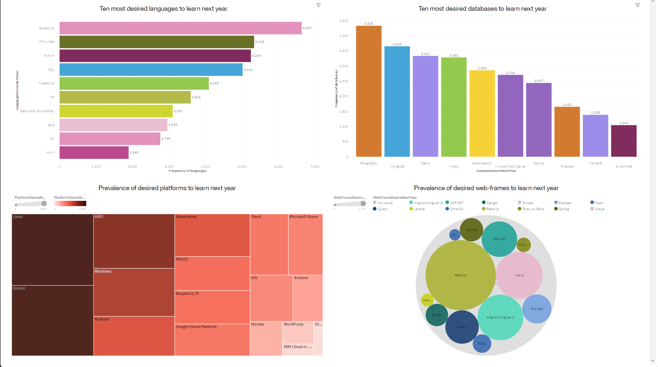
DASHBOARD TAB 2

Slide 14
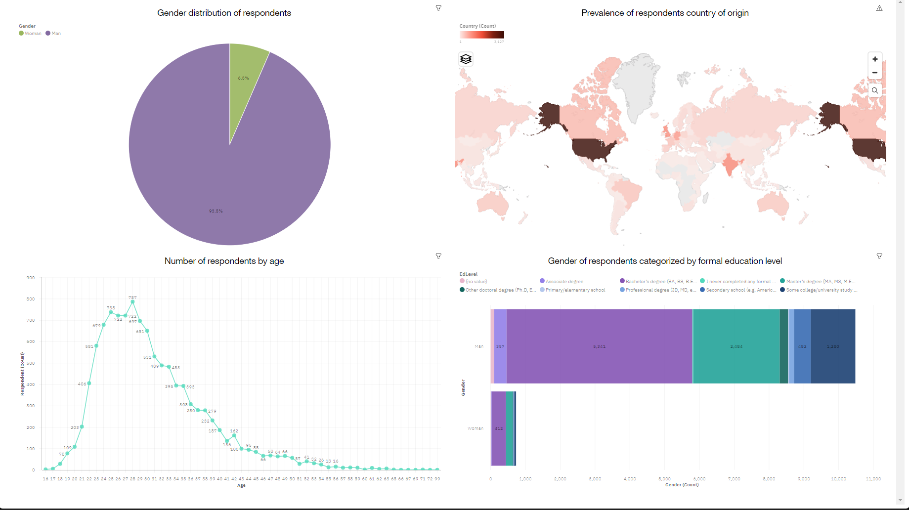
DASHBOARD TAB 3

Slide 15
DISCUSSION
There is a high gender and age disparity in the industry from low female and higher age participation
There is also a geographic disparity
There needs to be a further push in reskilling developers and filling in the demographic gaps in

Slide 16
OVERALL FINDINGS & IMPLICATIONS
Findings
Very glaring disparities in age, Gender, and location in developer hiring
Fast growing sectors in open sourced technologies
Importance of currently used platforms and webframe-works stay about the same
Implications
Companies that stay competitive will need to fill in these disparities in developer hiring
Investment in independent developers could improve company profits
Industry might be staying stagnant in terms of platforms and webframe-works used

Slide 17

CONCLUSION
Developers vary in terms of their priorities with some notable trends. For instance, Preferring to branch out to new and open-sourced languages and databases over proprietary technologies
There is a need to encourage use of new platforms and web frameworks over those currently in use
There needs to be a push to fill in demographic gaps in hiring

Slide 18
APPENDIX
DASHBOARD TABS created on Cognos Analytics Dashboards

Slide 19
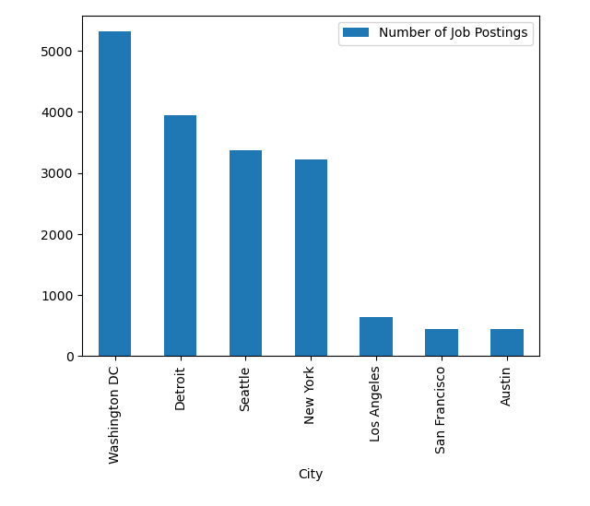
JOB POSTINGS

Slide 20
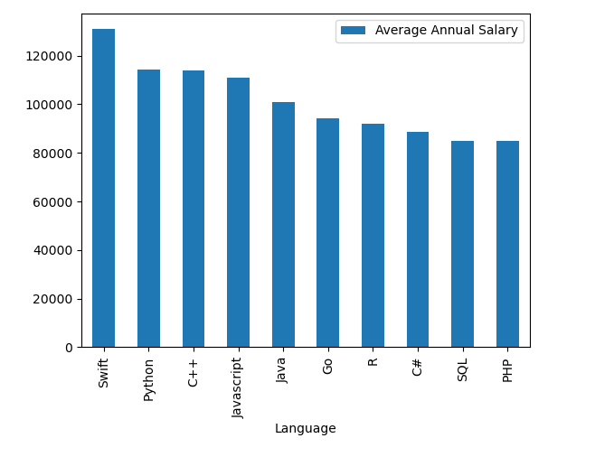
POPULAR LANGUAGES

